Slide 1

ITE61
Enterprise Systems Architecture

Slide 2
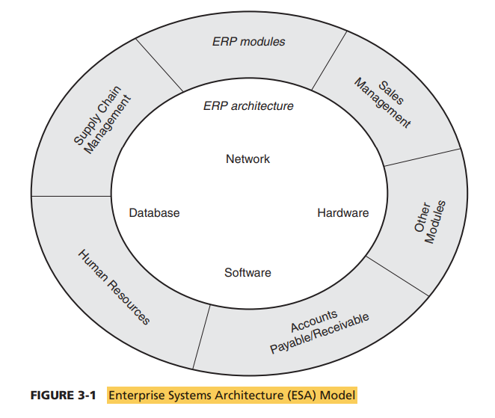
ITE61
Enterprise System Architecture
The enterprise systems architecture can be viewed from two different angles: (1) the functional angle that defines the ERP modules that support the various business functions of the organization and (2) the system angle that defines the ERP architecture through the physical components of hardware, software, and networking.

Slide 3
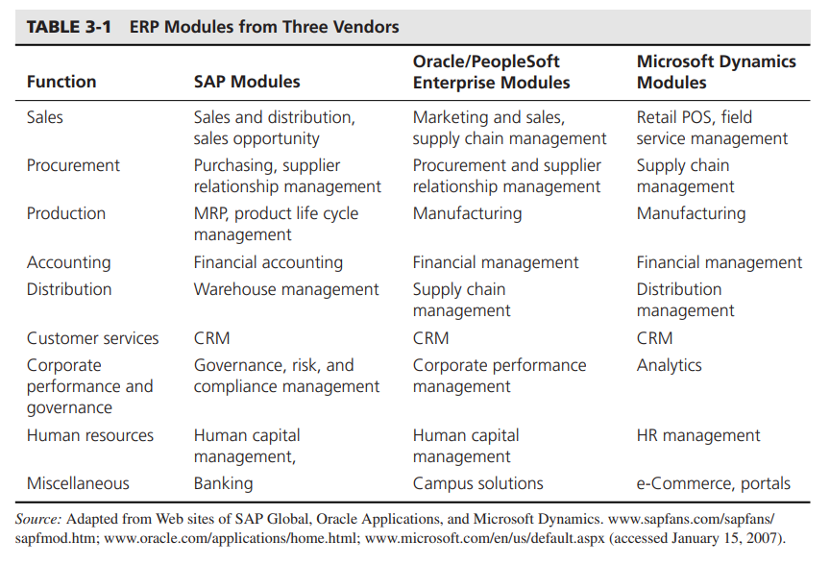
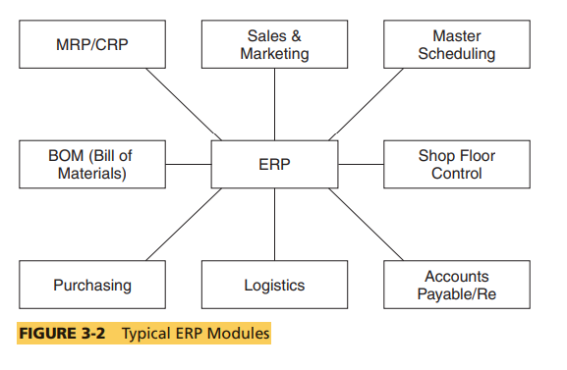
Pitch Deck
ERP Modules

Slide 4
ITE61
Benefits of Key ERP Modules
1
Self Services
2
Performance Management
3
Financials
4
HR Management
5
Procurement and Logistics Execution
6
Product Development and Manufacturing

Slide 5
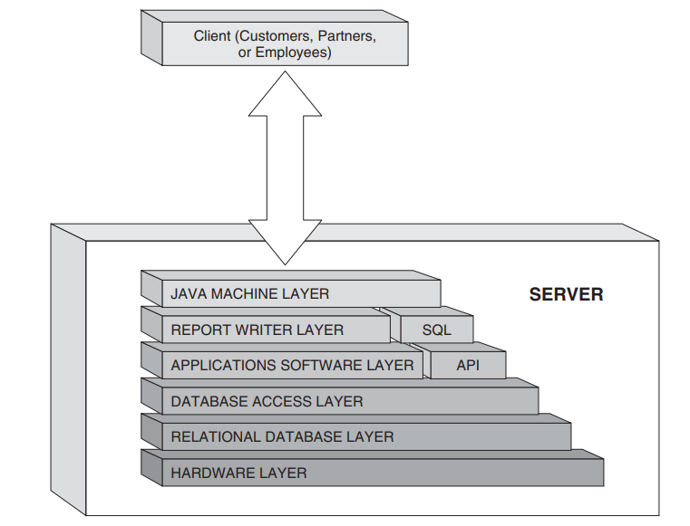
ITE61
ERP Architecture
Layered Architecture
This architecture generalizes the functional layers to allow it to change with newer technologies.

Slide 6
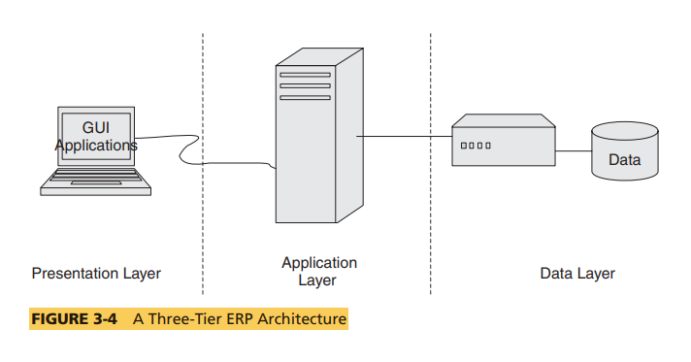
ITE61
THREE-TIER ARCHITECTURES
Most of the current ERP implementations follow a three-tiered architecture, which consists of a Web tier, an application tier, and a data tier.

Slide 7
ITE61
Benefits and Limitations
1
Scalability
1
Economics
2
Reliability
2
Economics
3
Flexibility
4
Reusability
5
Security

Slide 8

ITE61
Web Services Architecture
In the last decade, many ERP vendors have introduced Web (or Internet)-based architecture for their systems. This is often described as a fourth tier where the Web tier is split into services tier and browser tier
This next-generation architecture leverages a number of Internet technologies and concepts to deliver simple, ubiquitous access to ERP application modules and to enable the open flow of information between systems.

Slide 9
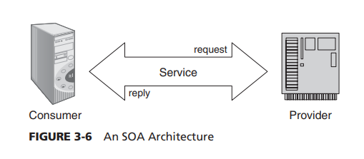
ITE61
Service Oriented Architectures
A service is a function that is well defined, self-contained, and does not depend on the context or state of other services.
From an ERP perspective SOA decomposes the business tier into smaller, distinct units of services. These services collectively support an ERP functional module

Slide 10
ITE61
SOA and Web Services
Web services basically are interfaces that allow different software applications and components to be operated together. Web services are necessary because different applications operate in dissimilar ways.
One special feature of Web services is that the IT industry reached a consensus on certain standards concerning the communication of applications to other applications.

Slide 11
ITE61
Enterprise Content Management and SOA
Enterprise content management strategies and tools mainly concentrate on managing any unstructured information that exists in an organization. Nevertheless, enterprise content management is also about supporting business goals, not just managing content itself.
Now due to SOA, the software market for enterprise content management is being overhauled. Vendors have come to an understanding that content management takes advantage of technology and information assets across the business and is no longer application specific.

Slide 12
ITE61
Cloud Computing
Cloud computing (CC) has recently emerged as a powerful platform to support the growing needs of many organizations that do not want to own and maintain complex software systems for the enterprise.
The cloud computing platform provides a great alternative for these organizations as they do not have to purchase, install, or maintain the software applications, nor do they have to worry about security, privacy, and legal issues associated with data storage (assuming they choose to store their data bases on the cloud environment).

Slide 13

ITE61
Thank You For Your Attention!

